Slide 1
Lecture 5: Introduction to Linear Programming

Slide 2
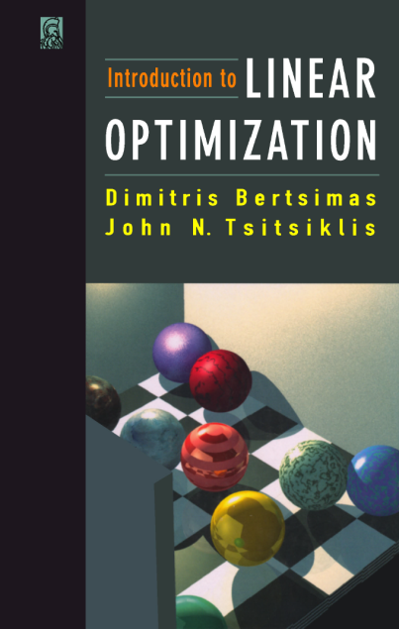
LP Textbook

Slide 3
Optimization problem/program
objective
“minimize”
domain
“subject to”

Slide 4
Linear program

Slide 5


Diet problem
Costs:
nutrient 1
nutrient 2
Content of nutrient n in a unit of a product i
….
nutrient N

Slide 6
Diet problem
Minimize the cost, so that all required nutrients are supplied:
Required daily amount

Slide 7
Diet problem
Minimize the cost, so that all required nutrients are supplied:

Slide 8


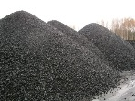
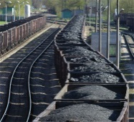




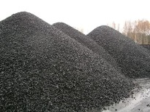
Coal supply, delivery, and consumption

Slide 9
Mining
M mines
max amount of coal per day
cost per ton
how much do we mine at day t at mine m

Slide 10
Energy production
S stations
min burning amount (in tons of coal)
max burning amount (in tons of coal)
how much coal to burn at station s at day t
produced power
cost of production

Slide 11
Transportation and storage
transportation cost from mine m to station s
maximum capacity of the storage at station s
initial amount of coal at station s
how much coal to send from m to s on day t
how much coal remains at station s after day t

Slide 12

Meeting the demand
predicted demand at day t

Slide 13
Putting it all together: objective
mining
transportation
power generation

Slide 14
Putting it all together: constraints
a mine has a limited output
transporting everything mined
coal balance
coal storage bounds
power plant operation constraint
meeting the demand

Slide 15
Overhead view

Slide 16
Overhead view
Notes:
Unbounded case, optimal value = -inf

Slide 17
Overhead view
Notes:
Infeasible case, optimal value = +inf

Slide 18
Overhead view

Slide 19
Optimality and active constraints
active constraints
Corollary 1: if LP is feasible and bounded, then there exist an optimal point with full rank .
Notes:
Both statements extend to the case when we have equality constraints (they are always active)

Slide 20
Optimality and active constraints
active constraints
Corollary 2: if x is feasible w.r.t. the polytope and its rank of is full, then there exist p, so that x is optimal.
Notes:
Both statements extend to the case when we have equality constraints (they are always active)

Slide 21
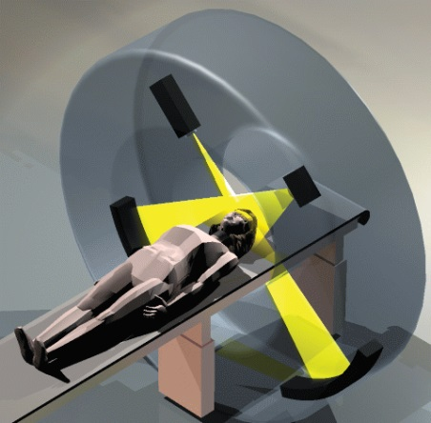
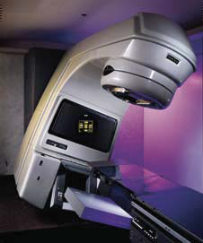
Radiation treatment
One of the main cancer treatment therapies (600,000+ a year in the US)
Multiple beams of radiation
Radiation kills both healthy and cancer cells (healthy cell have better self-repair)

Slide 22
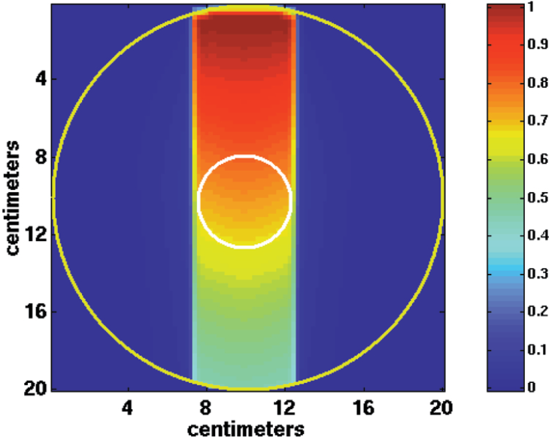
Radiation intensity
[Shepard et al. Optimizing the delivery of radiation therapy to cancer patients. SIAM Rev’99]

Slide 23
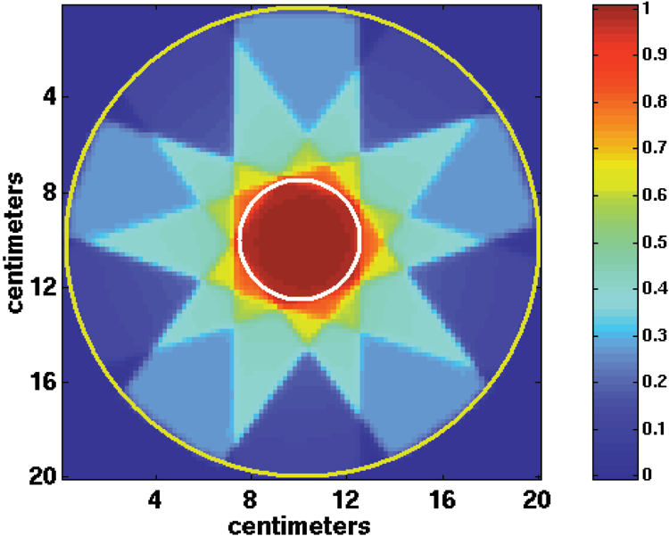
Combining beams
[Shepard et al. Optimizing the delivery of radiation therapy to cancer patients. SIAM Rev’99]

Slide 24
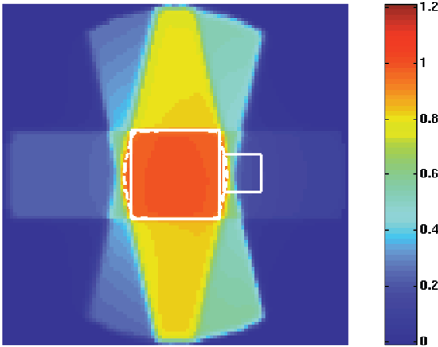
Radiation intensity
[Shepard et al. Optimizing the delivery of radiation therapy to cancer patients. SIAM Rev’99]
Notes:
Dashed line – 90%

Slide 25
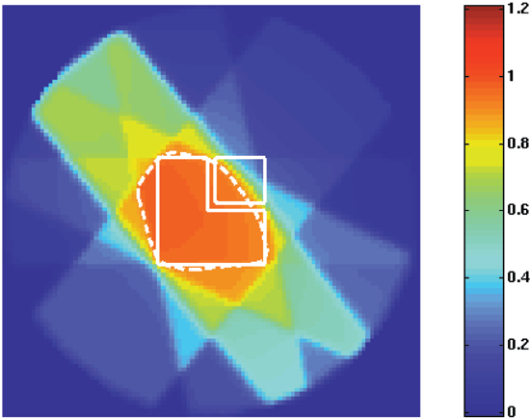
Radiation intensity
[Shepard et al. Optimizing the delivery of radiation therapy to cancer patients. SIAM Rev’99]
Notes:
Dashed line – 90%

Slide 26
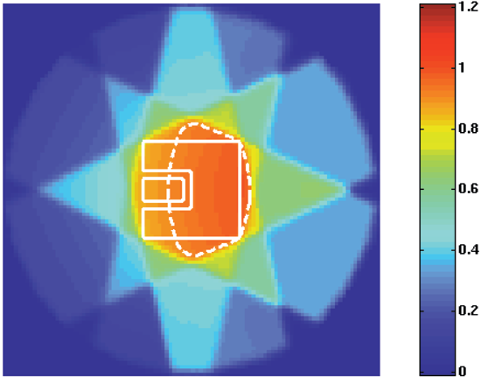
Radiation intensity
[Shepard et al. Optimizing the delivery of radiation therapy to cancer patients. SIAM Rev’99]
Notes:
Dashed line – 90%

Slide 27
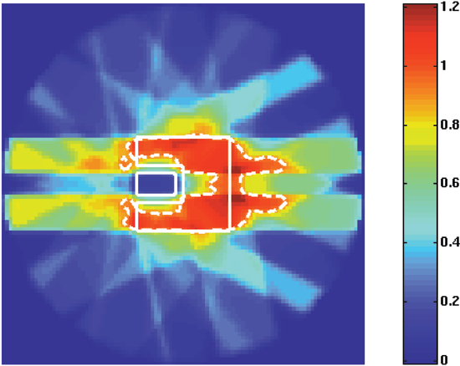
Segmented beam delivery
[Shepard et al. Optimizing the delivery of radiation therapy to cancer patients. SIAM Rev’99]
Notes:
Dashed line – 90%
This type of geometry would be seen
clinically if a tumor had grown around a patient’s spinal cord or brain stem.

Slide 28
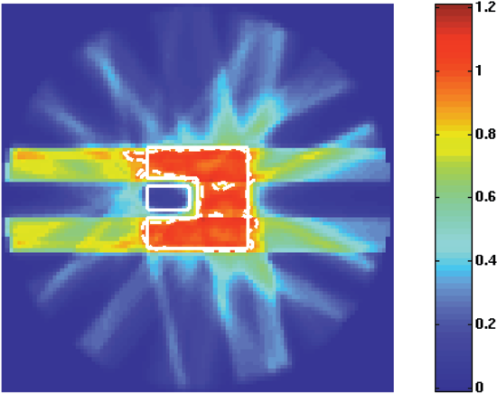
IMRTdelivery
[Shepard et al. Optimizing the delivery of radiation therapy to cancer patients. SIAM Rev’99]
Notes:
Intensity modulated radio therapy (upto tens of thousand beamlets)

Slide 29

LP formulation
- amount of radiation (in Gy) delivered by beam i to cell p if the beam is emitted at a unit power

Slide 30
The program
minimal dose to kill cancer cells
maximal dose that is safe for critical regions
Notes:
Caution: p is now index (not the objective vector)!

Slide 31
The robustified program

Slide 32
Piece-wise linear costs
penalty

Slide 33
Piece-wise linear costs
penalty
penalty

Slide 34
LP for piecewise-linear functions
Equivalent LP:

Slide 35
Functions and upper envelopes
f is convex iff it can be represented as an upper envelope of linear functions
In high dimensions, the approximation may require too many functions
More efficient convex optimizers (not reducing to LP) exist

